Slide 1
Hypercritical C++ Code Review
Yuri Minaev
minev@viva64.com

Slide 2

About me
A C++ developer at PVS-Studio.
Working on the core functionality and diagnostic rules of the C/C++ static code analyzer.

Slide 3
What is this about?
We all do code reviews
Who doesn't admit this – does it twice as often
It's ok, nobody's gonna blame you
Just make sure, you take precautions

Slide 4

What are you talking about?
We all do code reviews
Who doesn't admit this – does it twice as often
It's ok, nobody's gonna blame you
Just make sure, you take precautions

Slide 5
Aut'o'matic

Slide 6
void foo(const std::vector<....> &vec)
{
for (auto i = 0; i < vec.size(); ++i)
{
// do some magic with vec[i]
}
}
int i = 0;

Slide 7
void foo(const std::vector<....> &vec)
{
for (auto i = 0; i < vec.size(); ++i)
{
// do some magic with vec[i]
}
}
Bad for x64

Slide 8
void foo(const std::vector<....> &vec)
{
for (auto i = 0; i < vec.size(); ++i)
{
// do some magic with vec[i]
}
}
Signed/unsigned mixup

Slide 9
void foo(const std::vector<....> &vec)
{
for (size_t i = 0; i < vec.size(); ++i)
{
// do some magic with vec[i]
}
}
Better

Slide 10
void foo(const std::vector<....> &vec)
{
for (auto i = 0ull; i < vec.size(); ++i)
{
// do some magic with vec[i]
}
}
128-bit systems, anyone?

Slide 11
void foo(const std::vector<....> &vec)
{
for (auto&& item : vec)
{
// do some magic with item
}
}
Look, I fixed it

Slide 12
Misreference

Slide 13
auto other =
static_cast<const Self &>(rhs_);
const T &a = data[n];
const T &b = other.data[m];
// Do stuff
:(

Slide 14
auto& other =
static_cast<const Self &>(rhs_);
const T &a = data[n];
const T &b = other.data[m];
// Do stuff
Look, I fixed it

Slide 15
decltype(auto) other =
static_cast<const Self &>(rhs_);
const T &a = data[n];
const T &b = other.data[m];
// Do stuff
If you're really into it

Slide 16
Thou shalt not auto, unless thy faith is strong and pure

Slide 17


Slide 18

Versus Intuition

Slide 19
using V = std::vector<....>;
void vector_inc(V &v)
{
for (size_t i = 0; i < v.size(); i++)
{
v[i]++;
}
}

Slide 20
for (size_t i = 0; i < v.size(); i++)
{
v[i]++;
}
Which is faster?
std::vector<uint32_t> &v;
std::vector<uint8_t> &v;

Slide 21
Let's benchmark, shall we?
Compiler | Element | -O1 | -O2 | -O3
gcc 8 | uint8_t | 2.0 | 2.0 | 2.0
gcc 8 | uint32_t | 2.3 | 1.3 | 0.2
clang 8 | uint8_t | 9.2 | 2.0 | 2.0
clang 8 | uint32_t | 9.2 | 0.2 | 0.2

Slide 22
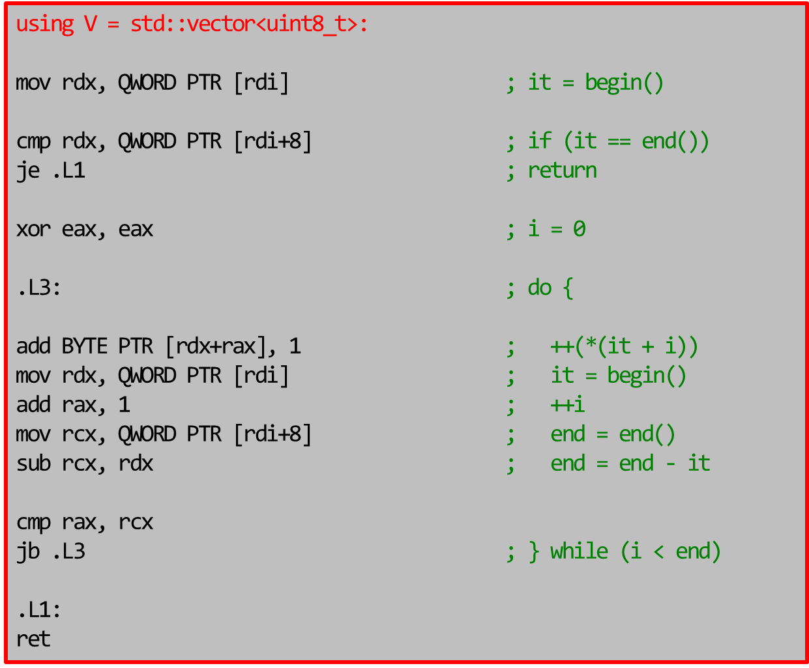

Slide 23
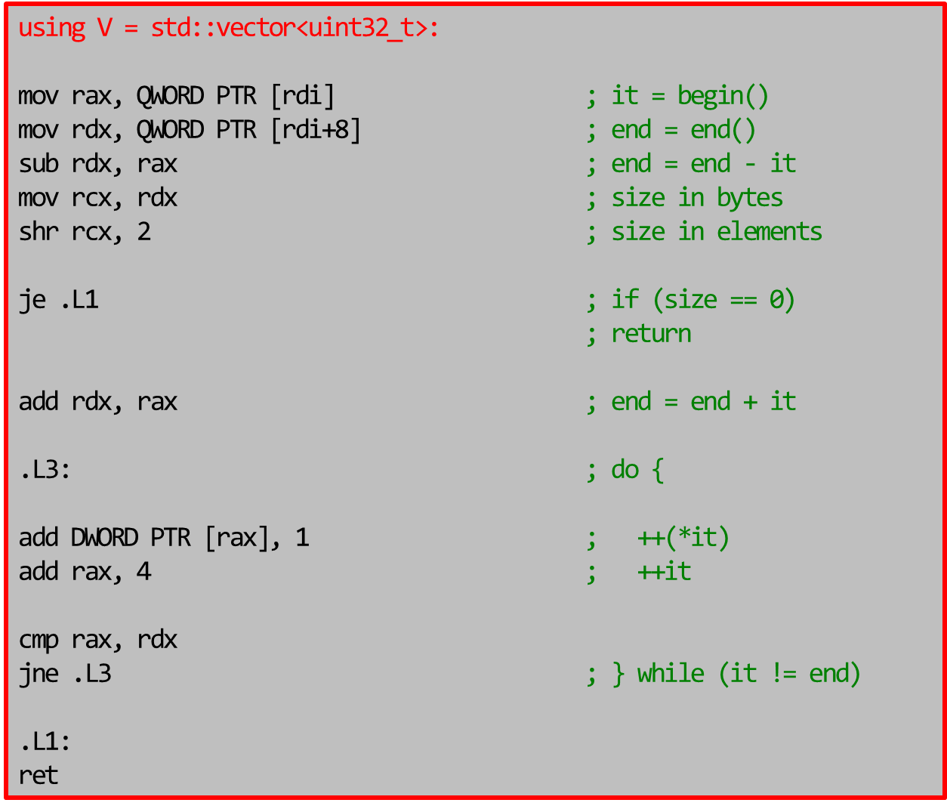

Slide 24
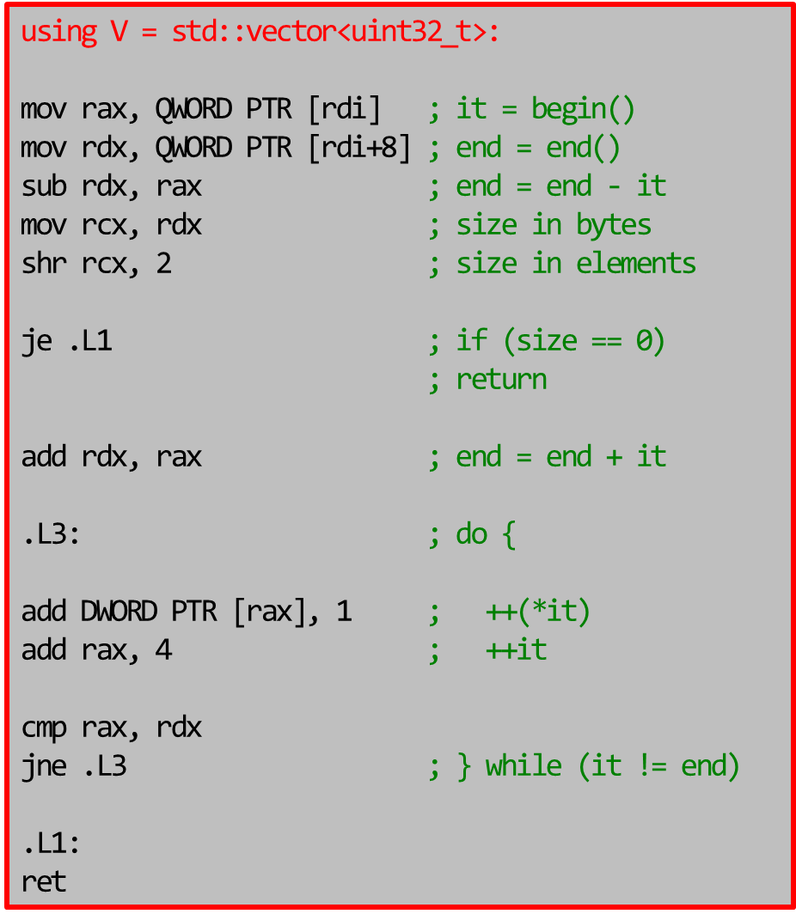
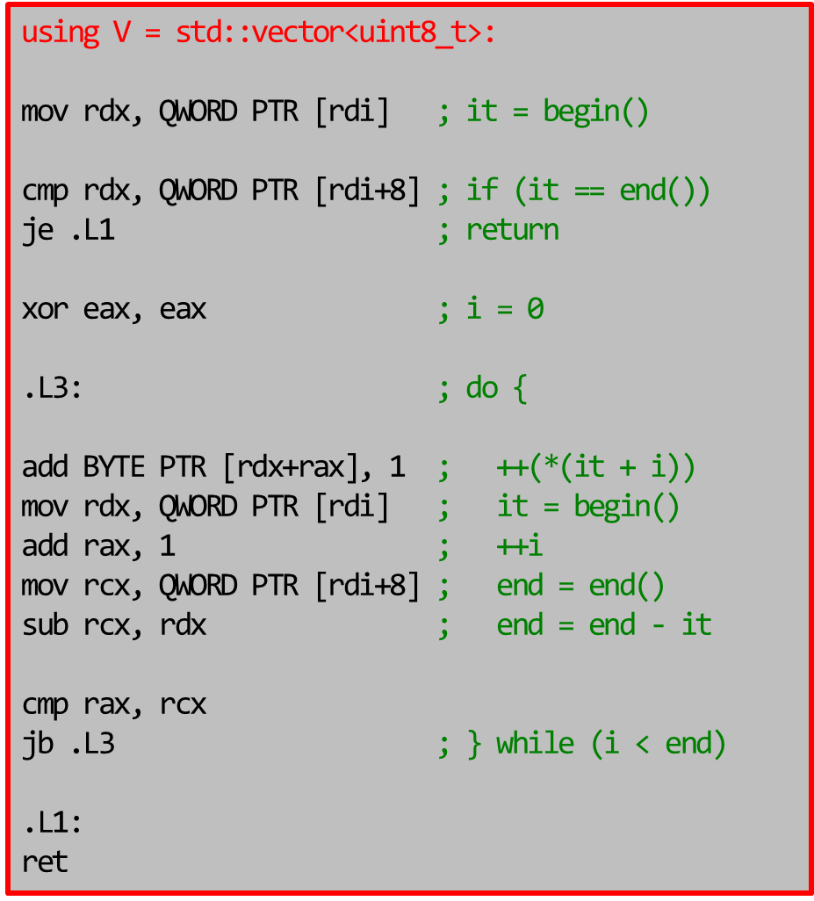

Slide 25
// using V = std::vector<uint8_t>;
auto it = v.begin();
const auto end = v.end();
for (; it != end; ++it)
{
++(*it);
}

Slide 26
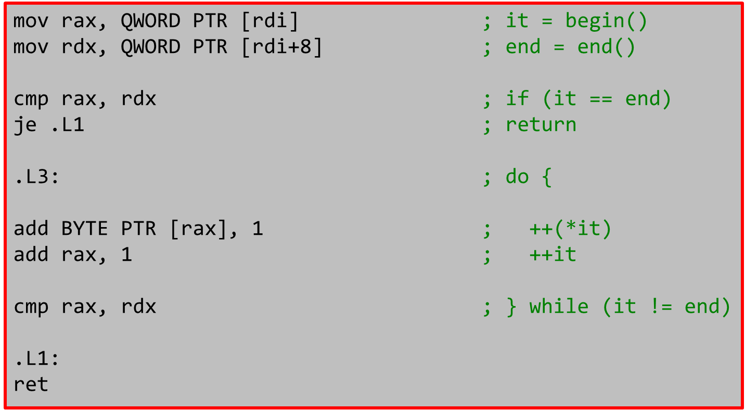

Slide 27
One more (with uint8_t)
Compiler | Before (-O2) | After (-O2) | Speedup
gcc 8 | 2.0 | 1.3 | 1.5x
clang 8 | 2.0 | 0.06 | 33.4x

Slide 28
auto it = v.begin();
const auto end = v.end();
for (; it != end; ++it)
{
++(*it);
}
Does it remind you of anything?

Slide 29
How about this?
for (auto&& elem : v)
{
++elem;
}

Slide 30
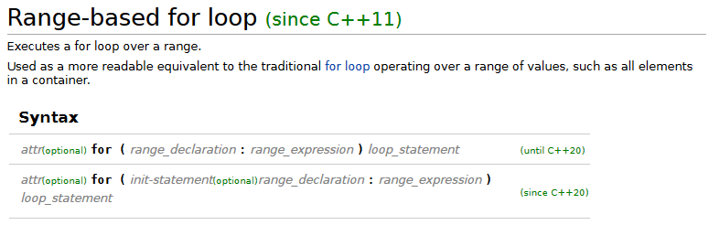
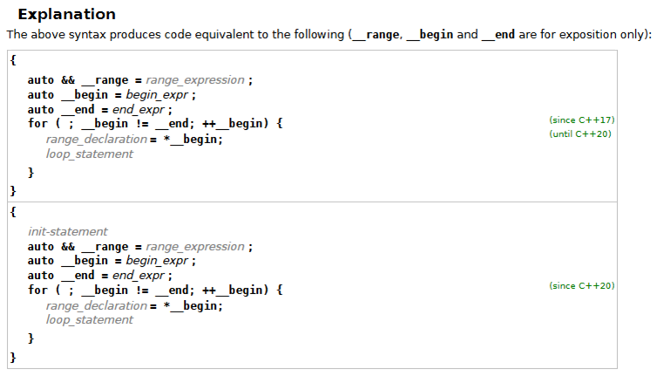

Slide 31
Thou shalt not write indexed loops for they are abomination before the Code

Slide 33
Privacy Matters

Slide 34
void InputPassword(char *pswd);
void ProcessPassword(const char *pswd);
void DoSomething()
{
char password[MAX_PASSWORD_LEN];
InputPassword(password);
ProcessPassword(password);
memset(password, 0, sizeof(password));
}

Slide 35
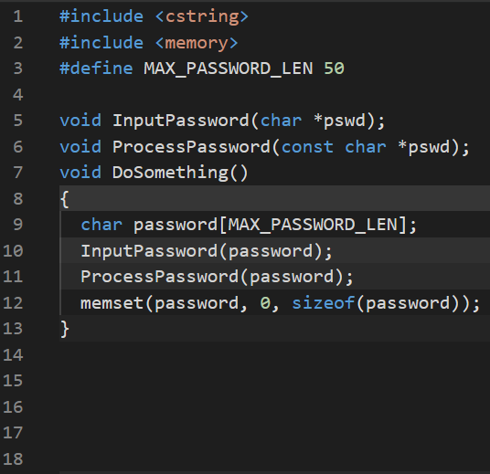
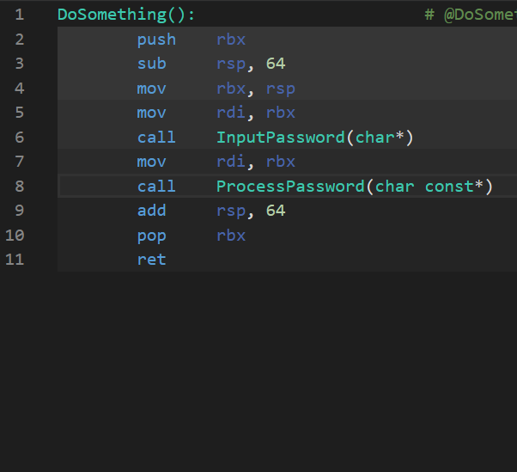
What does the compiler say?
clang 10 with –O2

Slide 36
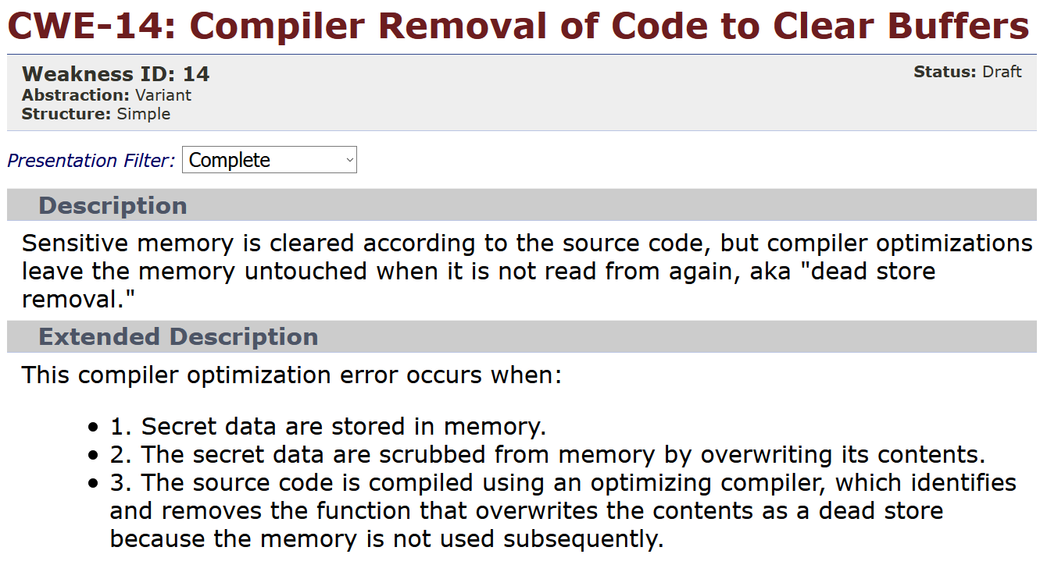
Looks contrived?

Slide 37
So, what can you do?
Custom safe_memset + disabled LTO/WPO
Access a non-volatile object through a volatile pointer
Call memset through a volatile function pointer
Volatile assembly code
Memset + memory barrier
Disable compiler optimisations (-fno-builtin-memset)
C11: memset_s

Slide 38
Thou shalt wash thy data thoroughly before releasing it

Slide 39
Unwashed Data

Slide 40

if (!fgets(readbuf, BUFSIZ, stdin))
{
// ....
}
if(readbuf[strlen(readbuf) - 1] == '\n')
readbuf[strlen(readbuf) - 1] = '\0';
CVE-2015-8948

Slide 41
if (!fgets(readbuf, BUFSIZ, stdin))
{
// ....
}
if(readbuf[strlen(readbuf) - 1] == '\n')
readbuf[strlen(readbuf) - 1] = '\0';
Put an empty line here
This goes BOOM

Slide 42
if (getline(&line, &linelen, stdin)
== -1)
{
// ....
}
if(line[strlen(line) - 1] == '\n')
line[strlen(line) - 1] = '\0';
Look, I fixed it

Slide 43
if (getline(&line, &linelen, stdin)
== -1)
{
// ....
}
if(line[strlen(line) - 1] == '\n')
line[strlen(line) - 1] = '\0';
CVE-2016-6262

Slide 44
if (getline(&line, &linelen, stdin)
== -1)
{
// ....
}
if(line[strlen(line) - 1] == '\n')
line[strlen(line) - 1] = '\0';
Put an empty line here
This goes BOOM

Slide 45
Thou shalt not accept data from strangers for they might be sinful

Slide 46
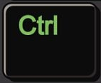


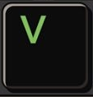
Last Mile

Slide 47
void Init( float ix=0, float iy=0,
float iz=0, float iw=0 )
{
SetX( ix );
SetY( iy );
SetZ( iz );
SetZ( iw );
}
SetW( iw );

Slide 48
if (access & FILE_WRITE_ATTRIBUTES)
output.append("\tFILE_WRITE_ATTRIBUTES\n");
if (access & FILE_WRITE_DATA)
output.append("\tFILE_WRITE_DATA\n");
if (access & FILE_WRITE_EA)
output.append("\tFILE_WRITE_EA\n");
if (access & FILE_WRITE_EA)
output.append("\tFILE_WRITE_EA\n");
Same blocks

Slide 49
if (
protocol.EqualsIgnoreCase("http") ||
protocol.EqualsIgnoreCase("https") ||
protocol.EqualsIgnoreCase("news") ||
protocol.EqualsIgnoreCase("ftp") ||
protocol.EqualsIgnoreCase("file") ||
protocol.EqualsIgnoreCase("javascript") ||
protocol.EqualsIgnoreCase("ftp")
) {
Double checking

Slide 50
Thou shalt not copy-paste thy code blocks

Slide 52
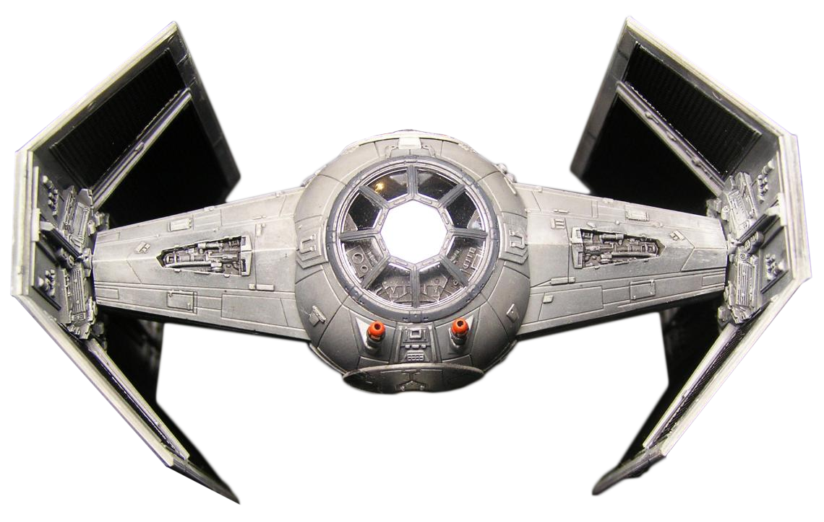
Have Spaceship, Will Travel
<=>

Slide 53
struct Foo
{
int a, b;
};
bool operator==(Foo lhs, Foo rhs)
{
return lhs.a == rhs.a
&& lhs.b == rhs.b;
}

Slide 54
struct Foo
{
int a, b;
};
bool operator==(Foo lhs, Foo rhs)
{
return lhs.a == rhs.a && lhs.b == rhs.b;
}
bool operator!=(Foo lhs, Foo rhs)
{
return !(lhs == rhs);
}
So far so good

Slide 55
How about these?
bool operator<(Foo lhs, Foo rhs) { ??? }
bool operator<=(Foo lhs, Foo rhs) { ??? }
bool operator>(Foo lhs, Foo rhs) { ??? }
bool operator>=(Foo lhs, Foo rhs) { ??? }

Slide 56
bool operator<(Foo lhs, Foo rhs)
{
return lhs.a < rhs.a
&& lhs.b < rhs.b;
}
So far so good

Slide 57
bool operator<(Foo lhs, Foo rhs)
{
return lhs.a < rhs.a
&& lhs.b < rhs.b;
}
Foo { 2, 1 } < Foo { 1, 2 }
false
Foo { 1, 2 } < Foo { 2, 1 }
false

Slide 58
bool operator<(Foo lhs, Foo rhs)
{
if (lhs.a < rhs.a) return true;
if (rhs.a < lhs.a) return false;
return lhs.b < rhs.b;
}
Foo { 2, 1 } < Foo { 1, 2 }
false
Foo { 1, 2 } < Foo { 2, 1 }
true

Slide 59
struct Foo
{
double a;
};
bool operator<(Foo lhs, Foo rhs)
{
return lhs.a < rhs.a;
}
bool operator>=(Foo lhs, Foo rhs)
{
return !(lhs < rhs);
}

Slide 60
bool operator<(Foo lhs, Foo rhs)
{
return lhs.a < rhs.a;
}
bool operator>=(Foo lhs, Foo rhs)
{
return !(lhs < rhs);
}
Foo { 1.0 } < Foo { 2.0 }
true
Foo { 1.0 } < Foo { NaN }
false
Foo { 1.0 } >= Foo { NaN }
true

Slide 61
So, what shall we do?
struct Foo
{
// anything
auto operator<=>(const Foo &rhs) const = default;
};

Slide 62
struct Foo
{
// anything
auto operator<=>(const Foo &rhs) const = default;
};
Foo { 2, 1 } < Foo { 1, 2 }
false
Foo { 1, 2 } < Foo { 2, 1 }
true
Foo { 1.0 } < Foo { 2.0 }
true
Foo { 1.0 } < Foo { NaN }
false
Foo { 1.0 } >= Foo { NaN }
false

Slide 63
While we're at it

Slide 64
const Ptree* pIf =
IsA(p, ntIfStatement, ntSwitchStatement)
? p
: IsA(First(p),
ntIfStatement, ntSwitchStatement)
&& ContainsNoReturnStatements(First(p))
? First(p)
: nullptr;

Slide 65
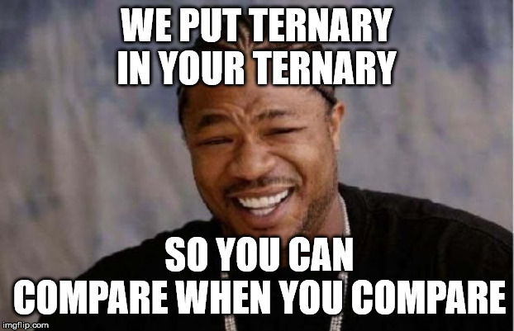
const Ptree* pIf =
IsA(p, ntIfStatement, ntSwitchStatement)
? p
: IsA(First(p),
ntIfStatement, ntSwitchStatement)
&& ContainsNoReturnStatements(First(p))
? First(p)
: nullptr;

Slide 66
Thy comparison routines shall be correct or else the Wrath of Code will get thee

Slide 67

Don't Push on Me

Slide 68
struct G584_Info
{
G584_Info(/*A bunch of params*/)
{/**/}
const Ptree *m_p;
bool m_add, m_mul;
bool m_sub, m_div;
};

Slide 69
auto what = p->What();
if (what == ntParenExpr)
{
// infs is std::vector<G584_Info>&
infs.push_back(
G584_Info(p, true, true, false, false)
);
p = SafeSkipParentesis(p);
}
Possible copy

Slide 70
auto what = p->What();
if (what == ntParenExpr)
{
// infs is std::vector<G584_Info>&
infs.emplace_back(
p, true, true, false, false
);
p = SafeSkipParentesis(p);
}
Better

Slide 71
struct G584_Info
{
G584_Info(/*A bunch of params*/)
{/**/}
const Ptree *m_p;
bool m_add, m_mul;
bool m_sub, m_div;
};
emplace_back this?
yes, since C++20

Slide 72
Thou shalt not push that which can be emplaced

Slide 73
Find It Again

Slide 74
auto&& infoMap = GetFunctionDangerousInfoMap();
auto it = infoMap.find(funcInfo);
if (it == infoMap.end())
{
infoMap.insert(
std::make_pair(funcInfo, dangerousInfo));
}
else
{
auto&& a = it->second;
}
Here we go again

Slide 75
auto it = infoMap.find(funcInfo);
if (it == infoMap.end())
{
infoMap.emplace(funcInfo, dangerousInfo);
}
else
{
auto&& a = it->second;
}
Better?

Slide 76
auto it = infoMap.find(funcInfo);
if (it == infoMap.end())
{
infoMap.emplace(funcInfo,
dangerousInfo);
}
else
{
auto&& a = it->second;
}
Double lookup

Slide 77
if (auto [it, success] =
infoMap.try_emplace(funcInfo,
dangerousInfo);
!success)
{
auto&& a = it->second;
}
Look, I fixed it

Slide 78
Thou shalt search only once

Slide 80
Mind The Sign

Slide 81
gcc is <ILLEGIBLE> broken
As I understand it, those <BEEP>ing <BAD PEOPLE> decided to <ILLEGIBLE> break everything again. It worked before and now it's broken.
For example, dropping the sign (a & 0x7fffffff) doesn't <BLEEP>ing work, and nothing works no more.
They always <FLIP>ing break everything, those <CENSORED>s. Take your <WEEP>ing UB and <...>

Slide 82
int foo(const char *s)
{
int r = 0;
while (*s)
{
r += ((r * 20891 + *s * 200)
| *s ^ 4 | *s ^ 3 )
^ (r >> 1);
s++;
}
return r & 0x7fffffff;
}
Signed
Overflow
Drop the sign

Slide 83
foo(char const*):
movzx edx, BYTE PTR [rdi]
test dl, dl
je .L4
xor esi, esi
.L3:
; lots of calculations
jne .L3
mov eax, esi
and eax, 2147483647
ret
.L4:
xor eax, eax
ret
Drop the sign

Slide 84
int foo(const char *s)
{
int r = 0;
while (*s)
{
r += ((r * 20891 + *s * 200)
| *s ^ 4 | *s ^ 3 )
^ (r >> 1);
s++;
}
return r & 0x7fffffff;
}
gcc -O2 -std=c++17 -funsigned-char

Slide 85
foo(char const*):
movzx edx, BYTE PTR [rdi]
xor r8d, r8d
test dl, dl
je .L1
.L3:
; lots of calculations
jne .L3
.L1:
mov eax, r8d
ret
Oops

Slide 86
Thou shalt not cook signed values with overflow semantics

Slide 87
Throwing Out
noexcept(BOOM)

Slide 88
void func() noexcept
{
// ....
throw SomeException{};
}
This is REALLY bad

Slide 89
void func() noexcept
{
anotherFunc();
}
void anotherFunc()
{
throw SomeException{};
}
This is also REALLY bad

Slide 90
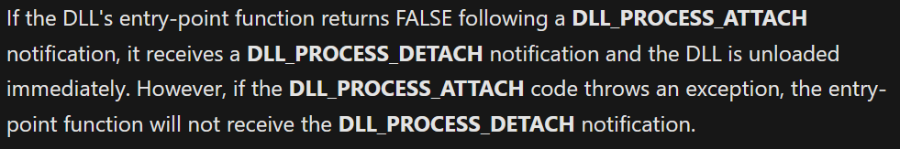
Not noexcept, but implies so
DllMain

Slide 91
BOOL WINAPI DllMain(/**/)
{
BOOL br = TRUE;
// ....
if (FAILED(DllRegisterServer()))
br = FALSE;
// ....
return br;
}

Slide 92
BOOL WINAPI DllMain(/**/)
{
BOOL br = TRUE;
// ....
if (FAILED(DllRegisterServer()))
br = FALSE;
// ....
return br;
}
PVS-Studio: don't throw from DllMain, mate

Slide 93
BOOL WINAPI DllMain(/**/)
{
BOOL br = TRUE;
// ....
if (FAILED(DllRegisterServer()))
br = FALSE;
// ....
return br;
}
PVS-Studio: don't throw from DllMain, mate
Me: LOLWUT?

Slide 94
DllRegisterServer
Part of Window API
Essentially, written in C
Related to COM
Doesn't throw
Looks buggy
Or does it?

Slide 95
HRESULT WINAPI DllRegisterServer(VOID)
{
// ....
hr = ::RegOpenKeyEx(/**/);
// ....
DllGetObjectInfo(/**/);
// ....
hr = ::RegSetValueEx(/**/);
// ....
RegCloseKey(hk);
}
These don't throw

Slide 96

HRESULT WINAPI DllGetObjectInfo(/**/)
{
// ....
hr = DllGetObject(/**/);
if (SUCCEEDED(hr))
{
// ....
delete pPlugin;
}
// ....
}

Slide 97

HRESULT WINAPI DllGetObject(
DWORD dwPluginId,
IShellPlugin **ppPlugin)
{
// ....
*ppPlugin = new CCommandPlugin;
// ....
}

Slide 98
He who is without noexcept shall throw, and none other

Slide 99
